Slide 1
The Emotional Body 28th February 2021
Re-energize & Re-motivate
Your Life Now!
BTTI Spring Workshop Series

Slide 2
Welcome
Presentation Eoin MacCuirc Today’s Host Christina Benson Co-host Mary McGuiggan

Slide 3
Tips for Meeting Attendees
Mute your microphone To help keep background noise to a minimum, make sure you mute your microphone when meeting starts - Be mindful of background noise
Position your camera properly If you choose to use a web camera, be sure it is in a stable position and focused at eye level, if possible. Doing so helps create a more direct sense of engagement with other participants.
Limit distractions Avoid multi-tasking – turn off mobile You’ll focus better if you refrain from replying to emails or text
Q&A You can use the CHAT feature which allows you to ask questions or comment on something while presentation is on going. We have allowed time for Q&A at the end.
Recording I would like to make you aware we are going to record for training purposes and monitoring purposes.

Slide 4
BTTI
Bio-Testing & Therapy has a holistic approach to health – emphasising the care of the whole person, not just on a physical level, but emotionally, mentally and spiritually, believing that all these systems are interrelated, dysfunction on any one level can lead to disorder in other parts of the body.
Fred gave us the ‘BASIC PRINCIPLES of the alternative approach to health’ which encourages the body’s unique capacity for self-healing.
Your Health is your responsibility
An important factor in Fred’s teaching was to empower individuals with knowledge and skills that could be used to maintain their own wellbeing.
Today’s webinar on The Emotional Body starts our Spring series of reenergizing and remotivating your life, hopefully the series will give you ‘food for thought’ and will support you on your journey in these changing times.
‘Keep it simple’
Freddie’s Fox

Slide 5
Re-energize & Re-motivate Your Life Now!
This series was inspired by Dr Libby Weaver’s book ’Exhausted to Energised’ And how similar her ‘3’ pillars of health are to the work of Freddie Fox Bio-Testing & Therapy
The Emotional Body (Feb) The Nutritional Body (Mar) The Bio-chemical Body (May)

Slide 6
The Emotional Body
We are all an emotional body!
Born with a body primed and ready to express your needs through emotions, and they influence all you feel, think, do, and speak.
Everything you encounter triggers your emotions, and then influences your health, relationships, perspective and perception of the world.
By learning and understanding more about emotions, you can develop skills to sense how they emerge and then express through your body
You can become more adept at self-regulating emotions, managing how you express them, and consciously shifting from undesirable emotional
states to more desirable ones.
The Emotional Body - by Laura Bond
Notes:
The Emotional Body: A Method for Physical Self-Regulation
by Laura Bond

Slide 7
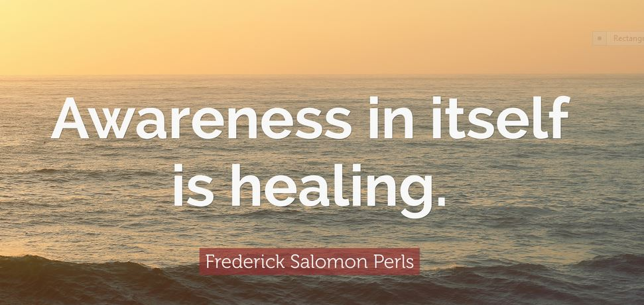
Frederick Salomon Perls
Fritz Perls was a 20th century psychiatrist who founded Gestalt therapy in collaboration with his wife, Laura Perls.
At the core of gestalt therapy is the holistic view that people are intricately linked to and influenced by their environments and that all people strive toward growth and balance.
Gestalt therapy places emphasis on gaining awareness of the individual’s present life and challenges that face them rather than delving into past experiences.
“Do not push the river, it flows by itself’’ Perls
Jack Kornfield

Slide 8
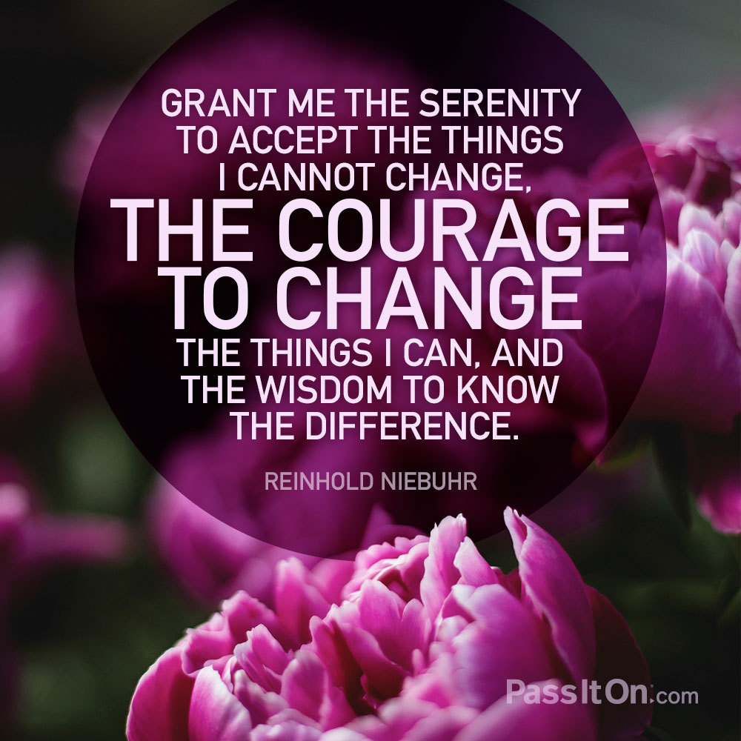
WIN – What’s Important Now!
WIN What’s Important Now

Slide 9
Breakout Rooms
Personal introductions 10 mins What emotions are you experiencing since the beginning of 2021? What’s important now?
When you come back please put in the chat 3 common themes that your group had come across during lockdowns
Please add the number of your room (Room 1) when giving feedback in the chat

Slide 10
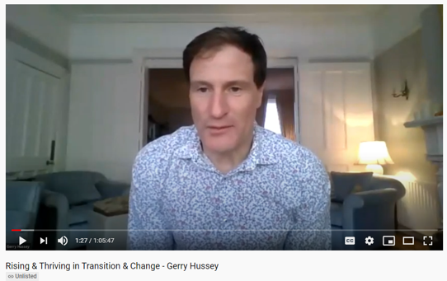
RISE above it all
Reframe – This might be the year that…Spring is here…I am so blessed…
Identify - how I win now, identify what you can go after and win…
Support Systems – who is on my team? Am I on my team? Habits?
Execute – Start and Complete, Focus, less tasks, perfect execution
https://www.youtube.com/watch?v=OU758ZM1APs&feature=youtu.be
Notes:
https://www.youtube.com/watch?v=OU758ZM1APs&feature=youtu.be
Gerry Hussey www.soulspace.ie
Can also be seen on his own site https://www.soulspace.ie/mental-fitness

Slide 11
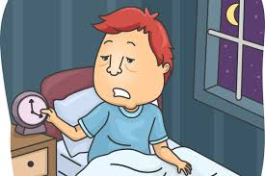
SLEEP – Lack/Loss
Sleep can be one of the first ‘RED FLAG’ indicators that there is something out of balance in our Nervous System
https://www.mind.org.uk/information-support/types-of-mental-health-problems/sleep-problems/about-sleep-and-mental-health/

Slide 12
PINEAL GLAND
In humans and other mammals, the daily rhythm of pineal melatonin production is driven by the 'master' circadian clock.
https://slideplayer.com/slide/9051841/

Slide 13
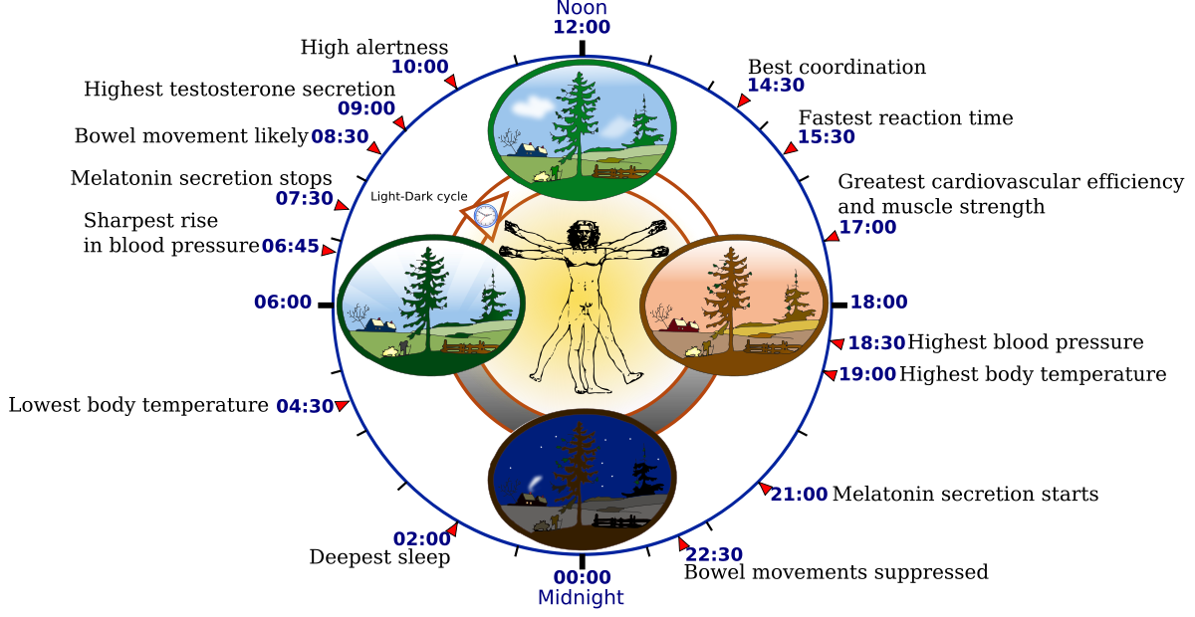
Circadian clock
Circadian rhythms are 24-hour cycles that are part of the body’s internal clock, running in the background to carry out essential functions and processes.
One of the most important and well-known circadian rhythms is the sleep-wake cycle.
https://www.sleepfoundation.org/circadian-rhythm
https://thewaytoabetterhealth.wordpress.com/2017/12/18/sleep-3-the-circadian-rhythm/

Slide 14
Mindful Breathing
The benefits of bringing attention to your breathing are measurable. By learning a few simple breathing techniques, you can:
“In order to fall asleep, mindful breathing can be very helpful; all it means is that, as you’re laying down
to go to sleep, you observe the breath.”
Deepak Chopra
Reduce stress levels in your body
Lower your heart rate
Lower your blood pressure
Improve diabetic symptoms
Reduce depression
Better manage chronic pain
Better regulate your body’s
reaction to stress and fatigue
https://homecareassistance.com/e-books/ultimate-guide-self-care/mindful-breathing-can-achieve-tremendous-health-benefits
Whatever breathing technique you use; The key is a long slow exhale.
Slow, rhythmic, diaphragmatic breathing. Breathing from your diaphragm, rather than shallowly from the top of the lungs stimulates and tones the Vagus nerve and improves decision making.

Slide 15
Dr Libby Weaver (PhD)
Dr Libby Weaver
“My mission is to educate and inspire, enhancing people’s health and happiness, igniting a ripple effect that transforms the world.”
An Australian Nutritional biochemist, a thirteen-times bestselling author, inspirational speaker and founder of the food-based supplement range, Bio Blends.
The pace of modern life versus our cavewoman biochemistry
Dr Libby Weaver https://www.youtube.com/watch?v=tJ0SME6Z9rw

Slide 16
Breakout Rooms
Discussion 15 mins The pace of modern life versus our cavewoman biochemistry Libby Weaver
When you come back please put in the chat 3 common themes/feelings that your group had come across after viewing this clip.
Please add the number of your room (Room 1) when giving feedback in the chat

Slide 17
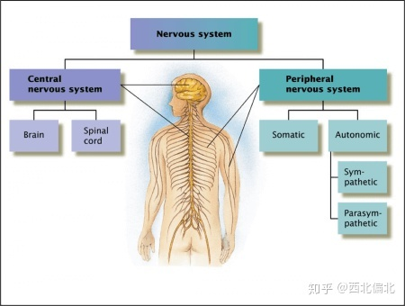
The Nervous System
The nervous system enables humans to react to their surroundings and to coordinate their behaviour.
It is the major controlling, regulatory, and communicating system in the body.
It is the centre of all mental activity including thought, learning, and memory.
Together with the endocrine, the nervous system is responsible for regulating and maintaining homeostasis.
Sub-Divisions
https://theydiffer.com/difference-between-the-endocrine-and-the-nervous-system/

Slide 18
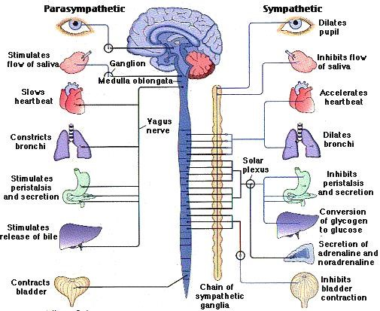
The Vagus Nerve
The Problem Indicators are:
Pain throughout the body
Polyarthritis
Pain along one half or one quarter of the body
Pain down one or both arms or legs
Knee or/and Hip pain
Sciatica
Frozen shoulder
One leg shorter than the other
Height reduction
Constipation
Colitis
Irritable bowel syndrome.
Extracted from - Freddie Fox’s Vagus Nerve Diagram
https://www.pinterest.com.mx/pin/207447126565378516/

Slide 19
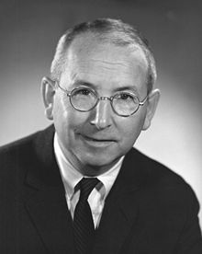
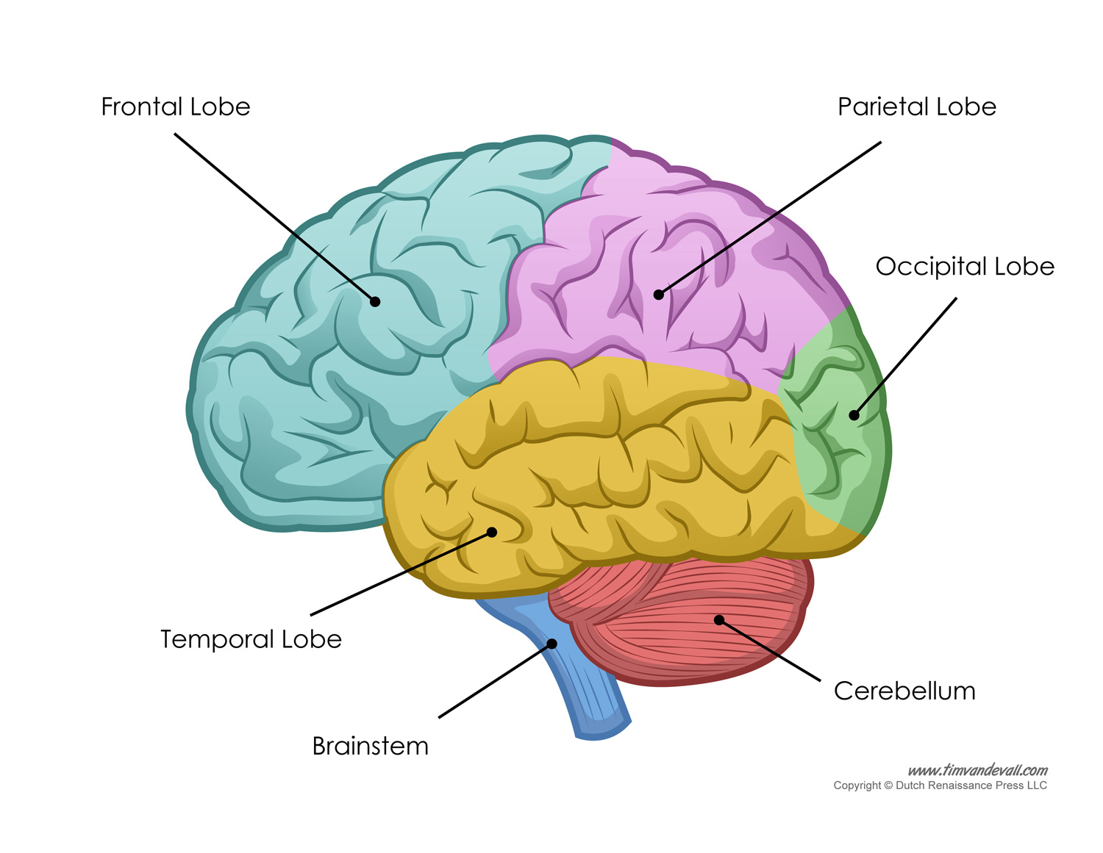
“Triune Brain”
Paul MacLean 1913 – 2007 An American physician and neuroscientist who made significant contributions in the fields of physiology, psychiatry, and brain research.
In the 1960’s Maclean developed the intriguing 3 Brain theory to explain its evolution and to try to reconcile rational human behaviour with its more primal and violent side.
.
The three regions are as follows:
Reptilian or Primal Brain
(Basal Ganglia)
Paleomammalian or Emotional Brain (Limbic System)
Neomammalian or Rational Brain (Neocortex)
From Wikipedia
These do not operate independently of one another
They have established numerous interconnections through which they influence one other.
The neural pathways from the limbic system to the cortex in the brain, are especially well developed.
https://rewardfoundation.org/brain-basics

Slide 20
“Triune Brain”
Paul MacLean
“triune brain” theory
https://rewardfoundation.org/brain-basics/evolutionary-development-of-the-brain/

Slide 21
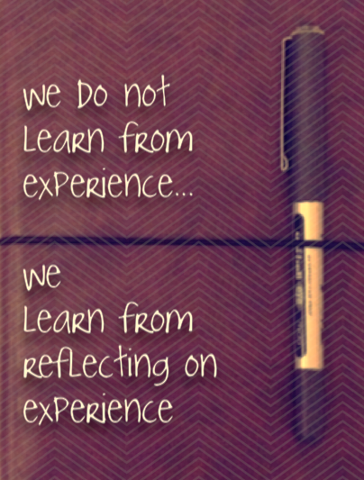
REFLECTION
Reflective Practice is simply a method of self-improvement.
Essentially Reflective Practice is a method of assessing our own thoughts and actions, for the purpose of personal learning and development, it gives you an increased sense of ownership to your learning.
This comes naturally to many but for others it must be developed.
A good start would be to keep a reflective journal.
To use this technique well and effectively it is important to be honest this lets you see that you are learning and growing, that you are aware of what you are doing, why you are doing it and how if in any way you can improve it!

Slide 22
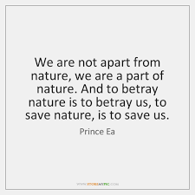
Maximizing your energy
START
STOP
KEEP
REFLECTION

Slide 23
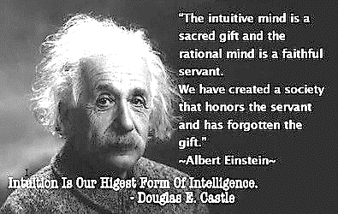
Intuition
Intuition is a form of knowledge that appears in consciousness without obvious deliberation. It is not magical but rather a faculty in which hunches are generated by the unconscious mind rapidly sifting through past experience and cumulative knowledge.
Often referred to as “gut feelings,” intuition tends to arise holistically and quickly, without awareness of the underlying mental processing of information.
www.psychologytoday.com
Freddie taught the theory
‘Your body knows what you need’
Learn to listen and rely on what you feel is right for you without needing validation externally.

Slide 24
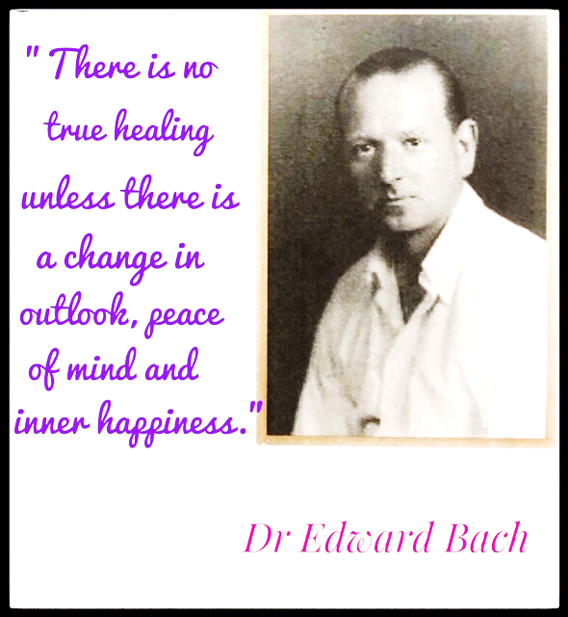
BACH FLOWERS
Edward Bach (pronounced 'Batch) was born in 1886 in England and qualified in 1912 as a doctor. was a visionary healer who recognized the soul-spiritual dimensions of healing, decades before this awareness gained public acceptance. Bach although trained in conventional medicine, knew that the physical symptoms he treated were intimately related to the emotional and mental conditions of his patients.
In the 1930s, He sought a natural, non-toxic method of addressing inner levels of human experience. Although widely recognized as an outstanding bacteriologist and homeopathic medical doctor, Bach left his practice to develop a new healing modality derived from the fresh blossoms of plants. During the time the world was suffering from the Great Depression, Fascism and Nazism.
Bach developed a set of 38 flower remedies which could help the human soul overcome fear, despair, and depression.
Notes:
https://bio-testing.org/the-therapy/history/
https://www.youtube.com/watch?v=4Qawj-0Uotw

Slide 25
Fr. Freddie Fox and Bach Flowers
Like Edward Bach Freddie also felt there was a mental and emotional aspect underlying health problems and In June 1993 he identified positive affirmations to counteract negative feelings associated with each flower remedy.
Using the positive affirmation should ensure that a healthy attitude and emotion will effectively replace negative ones which caused stress to the immune system and weakened the resistance to disease.
Freddie found that usually a person has more than one negative emotion or attitude to deal with and a difference Flower Remedy will be required for each.
People normally have 4 different “Inherited Factors” to deal with and may also have four different sets of emotions and attitudes to be dealt with.
Notes:
https://bio-testing.org/news/emotional-resilience-and-self-reliance-in-changing-times/bach-flower-affirmations-july-1993/
https://bio-testing.org/app/uploads/2021/02/2019-Autumn-Newsletter.pdf –article on Bach and on Affirmations

Slide 26
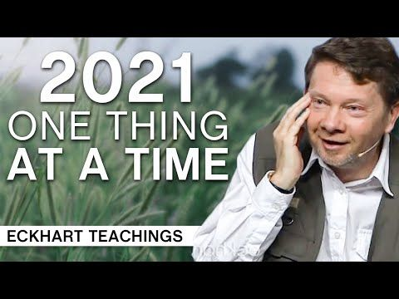
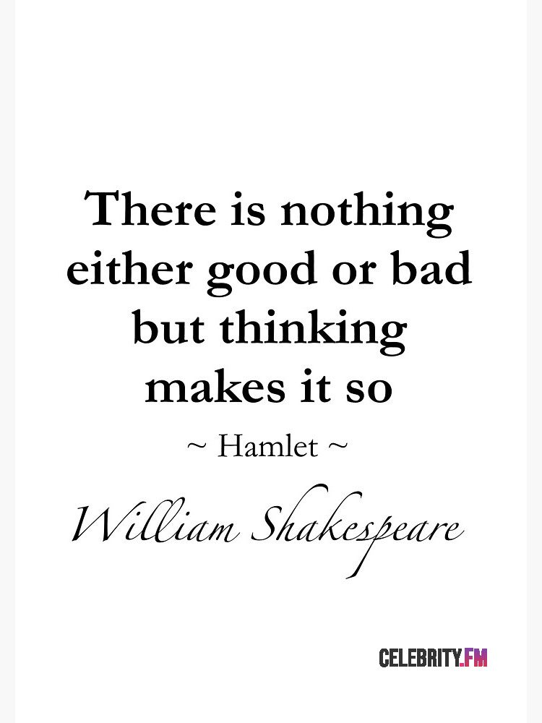
Eckhart Tolle – NOW
Starting 2021 Doing One Thing at a Time | Eckhart Tolle Teachings
Notes:
https://www.youtube.com/watch?v=z04JLGnFO48

Slide 27
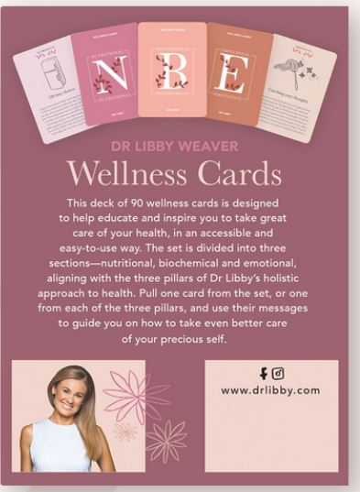
Dr Libby’s Wellness Cards
Notes:
https://shop.drlibby.com/product/wellness-cards?v=13b249c5dfa9

Slide 28
Contacts
Our web page www.bio-testing.org News - For resources from today’s session For membership form www.bio-testing.org/membership/ Email: bttiireland@gmail.com

Slide 29
Up & coming events
Next BTTI Webinar
The Nutritional Body
28th March 2021

Slide 30
Disclaimer
The content comprising all information contained in the attached PowerPoint presentation entitled ‘BTTI 2021 Spring Series’ is used solely for
Educational purposes in connection with private meetings of the BTTI Members and invited guests
The benefit of the stated attendees and it is not intended to and may not be relied upon by any person at any time whatsoever.
The Information may not be used, transmitted, referred to, quoted from, circulated, copied, filed with any governmental agency or authority, disseminated or disclosed by or to any other person or entity for any purposes without our prior written consent.
In circumstances where the Information is disclosed to any person other than the BTTI Members, such disclosure is for information purposes only and such person(s) may not rely upon the Information in any respect whatsoever.
The Information is not intended to advise on, replace or substitute traditional medical care, diagnosis, treatment or any professional advice in connection therewith and any person acting or relying upon the Information does so strictly at their own risk.
We do not accept or assume any liability of any nature whatsoever for reliance by any person on the Information and/or for any errors or omissions in the substance of the Information and we do not accept or assume any liability for the accuracy, completeness or relevance of the Information.

